Slide 1
Angular Component Trees
Peter Eijgermans peter.eijgermans@ordina.nl

Slide 2
Angular-app: Tree of components
<todo-app>
<todos-list>
<todo-item>
<todo-item>
{{ todo-text}}
{{ todo-text}}
{{ todo-checked}}
{{ todo-checked}}

Slide 3
Application as a tree of components
Steps to create Multiple child components?
Create a separate Child Component
Define this component in the app.module.ts
Add this component in the HTML of the parent-component
Repeat these steps for all other child components

Slide 4
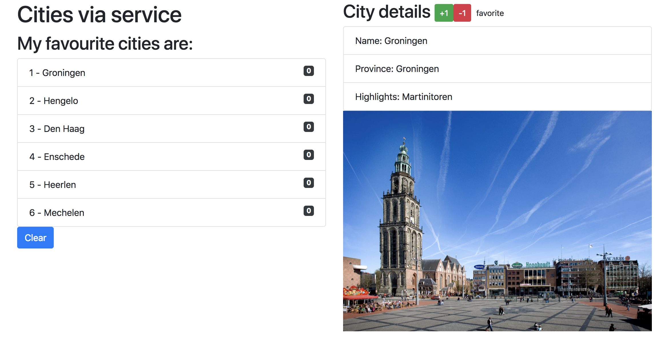

Slide 5
Component based
SideBarComponent
AppModule
AppComponent
CityListComponent
CityDetailComponent
Notes:
Angular apps are composed of modules.
Modules exports classes, function, values — that other modules import.

Slide 6
Component based A component adds logic to DOM elements Angular app consist of a treestructuur of components
main.ts
AppModule
AppComponent
app.component.html
CityListComponent
CityDetailComponent
city-detail.component.html
Notes:
Angular is a tree of components, because it has the same structure as your html-structure !!!
Index.html is the parent template of AppComponent ect…
AppComponent is the parent of BookComponent and …
main.ts

Slide 7
1. Create a separate City-detail component
// city.detail.ts
import { Component } from '@angular/core';
@Component({
selector: 'city‐detail', template: `
<h2>City details</h2>
<ul class="list‐group">
Nieuwe selector
Nog in te vullen
<li class="list‐group‐item">Naam: [naam van stad]</li>
<li class="list‐group‐item">Provincie: [provincie]</li>
<li class="list‐group‐item">Highlights: [highlights]</li>
</ul>
`
})
export class CityDetail{
}

Slide 8
2. Define this component in the app.module.ts
// app.module.ts
…
import {CityDetail} from "./city.detail"; // Nieuwe component invoegen
@ngModule({
…
declarations: […,CityDetail]
})
// Niet vergeten: invoegen bij declarations!
export class AppModule {
…
}

Slide 9
3. Add this component in the HTML of the parent-component
<!‐‐ app.html ‐‐>
<div class="row">
…
<div class="col‐md‐6">
…
<city‐detail></city‐detail>
</div>
</div>
Combineren met overige HTML

Slide 10
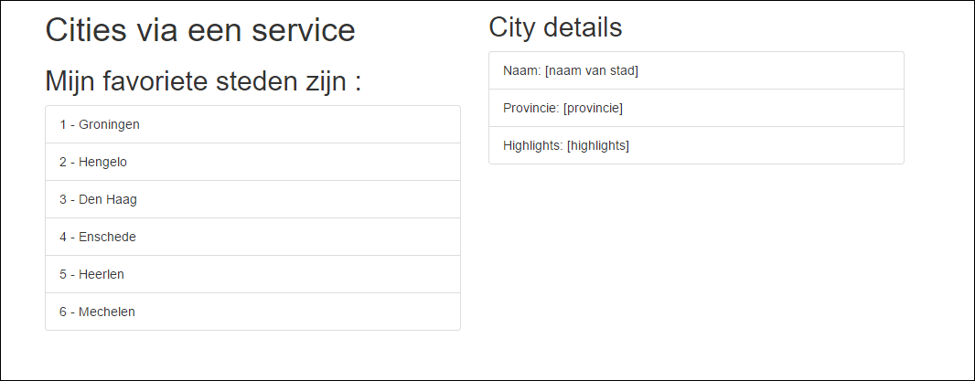
4. Result
To Do

Slide 11
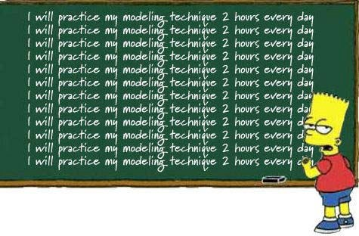
Checkpoint
See: 6a + 6b
Oefening….

Slide 12
Data flow between components
Use inputs and outputs

Slide 13
Data flow between components
“Data flows to a component via
@Input() ‘s”
Data flows out of a component via
@Output()’s”

Slide 14
@Input

Slide 15
Parent-Child flow: use annotation @Input()
<city-app>
[city]=“currentCity”
…
@Input() city: City
<city-detail>
{{ city.name}}
{{ city.province}}

Slide 16
Use @Input() in ChildComponent
Import the Input service in the component
Use the Annotation @Input() in the class definition
// city.detail.ts
import { Component, Input } from '@angular/core'; import { City } from "./city.model";
@Component({
…
})
Input
export class CityDetailComponent {
@Input() city: City;
}

Slide 17
Change the Parent HTML for @Input
<!‐‐ app.html ‐‐>
<div class="row">
<div class="col‐md‐6">
…
<ul class="list‐group">
<li *ngFor="let city of cities" class="list‐group‐item" (click)="getCity(city)">
{{ city.id}} ‐ {{ city.name }}
</li>
</ul>
</div>
<div *ngIf="currentCity">
<city‐detail [city]="currentCity"></city‐detail>
</div>
</div>
</div>
Aanpassing
Change!

Slide 18
Change the Parent Component Class
export class AppComponent {
// Properties voor de component/class
public cities:City[];
public currentCity:City;
… getCity(city) {
this.currentCity = city;
}
…
}

Slide 19
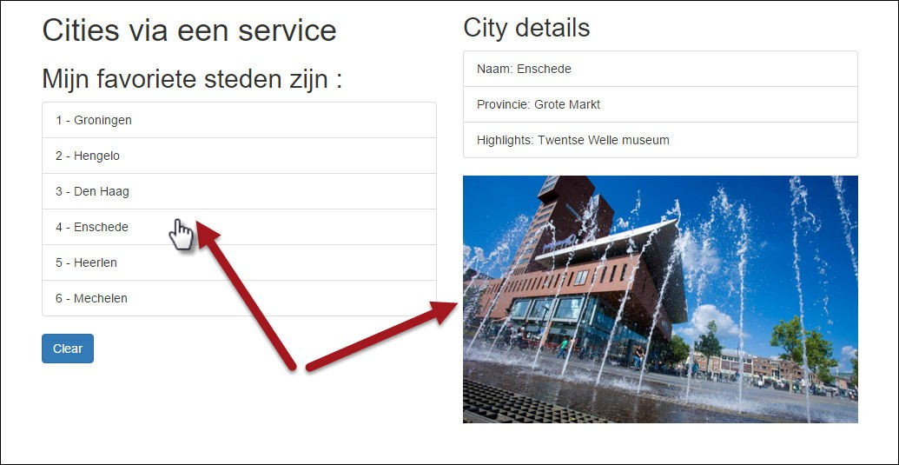
Result

Slide 20
Checkpoint
Data flow to Child Component : Use @Input() and
[propName]=“data”
See: 6c
Exercise….

Slide 21
@Output

Slide 22
Child-Parent flow: use annotation @Output()
<city-app>
(event)=“myEvent($event)”
…
@Output() event: EventEmitter<Type>
<city-detail>
{{ city.name}}
{{ city.province}}
P.165

Slide 24
Steps to take
Import Service Output in the CityDetailcomponent
Use annotation @Output() in de class definition
3. Define EventEmitter and the Type Annotation
“With @Output,
data flows up the Component Chain”
18

Slide 25
Give rating to Cities
// city.detail.ts
import { Component, Input, Output, EventEmitter} from ’@angular/core';
@Component({
… template: `
<h2>City details
<button (click)="rate(1)">+1</button>
<button (click)="rate(‐1)">‐1</button>
</h2>
…
`
})
Imports
Bind custom events to DOM
export class CityDetail {
@Input() city:City;
@Output() rating: EventEmitter<number> = new EventEmitter<number>();
Define & handle
rate(num) {
console.log('rating voor ', this.city.name, ': ', num); this.rating.emit(num);
}
custom
@Output event
}

Slide 26
Prepare Parent Component to receive custom event
<!‐‐ app.html ‐‐>
<div *ngIf="currentCity">
<city‐detail [city]="currentCity" (rating)="updateRating($event)">
</city‐detail>
</div>
// app.component.ts
// increase or decrease rating on Event Emitted
updateRating(rating){
this.currentCity.rating += rating;
}

Slide 27
Show Rating in the HTML of the Parent
<li *ngFor="let city of cities" class="list‐group‐item" (click)="getCity(city)">
{{ city.id}} ‐ {{ city.name }} ({{i}})
<span class="badge">{{city.rating}}</span>
</li>
Rating

Slide 28
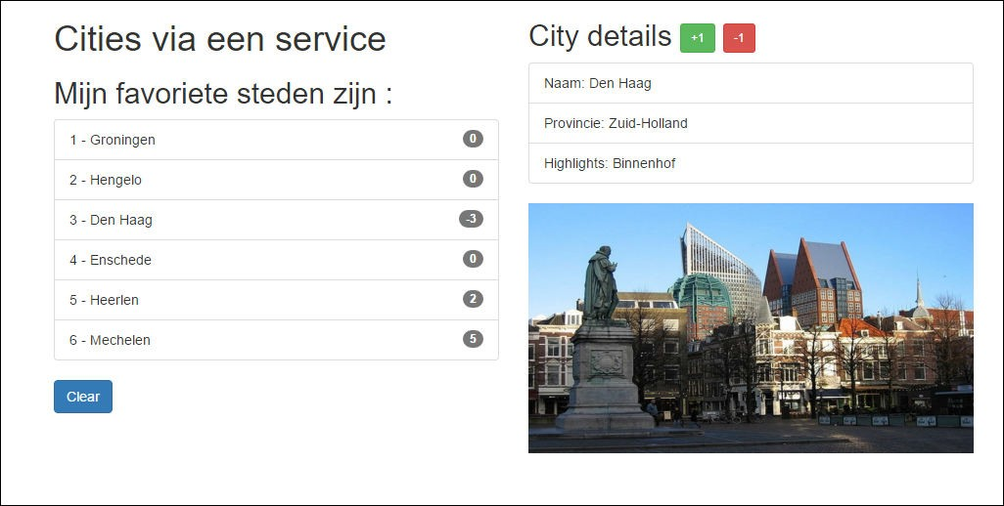
Result

Slide 29
Summary
Parent → Child
Child → Parent
<app>
<app>
[city]=“someCity”
(rate)=“onRate()”
<city-list>
<city-list>
[city]=“someCity”
(rate)=“onRate()”
<city-detail>
<city-detail>

Slide 30
Checkpoint
Data flow to Parent Component : use @Output() and
(eventName)=“eventHandler($event)”
See 6d
Exercise….

Slide 31











Communication between siblings
via Output() van een childcompo andere childcompon
< >
ut() van
ent
parent
Handle someEvent, set someProperty
[someProperty]=“someProperty”
meEvent)=“someE
(so
vent()”
<child-
1>
<child-2>
emo: 12a-components-siblin
T-IT
D
gs
5HAR

Slide 32
Use Pub/Sub-systeem with Observables
“Custom events, use an event bus”

Slide 33
Event bus
Event
App
<component-1>
<component-4>
<component-2>
<component-3>
<component-5>
{{…}
}
{{…}
}
{{…}
}

Slide 34
Use Subject
From RxJs-bibliotheek, use :
Subject() (is Observable and also Observer)
“Publish en Subscribe” – PubSub systeem

Slide 35
<city-list>
<city-details>
Book now!
publish
Event
<city-orders>
subscribe

Slide 36
PubSub-service maken
Step 1 – Make a Publication service
Step 2 – Create ‘Producer’ or ‘Publish’ – component
Step 3 – Create Subscriber-component

Slide 37
1. OrderService
// order.service.ts
import {Subject} from "rxjs/Subject"; import {Injectable} from "@angular/core"; import {City} from "../model/city.model";
@Injectable()
export class OrderService { stream:Subject<City>;
constructor() {
this.stream = new Subject<City>();
}
}

Slide 38
2. Producer component (‘book now’- button)
In de HTML:
<h2>Prijs voor een weekendje weg:
{{ city.price | currency:'EUR':true:'1.2' }}
<button class="btn btn‐lg btn‐info" (click)="order(city)">Book now!</button>
</h2>
In de class:
// Order plaatsen. Event emitten voor deze stad.
// Dit gaan opvangen in city.orders.ts
public order(city) {
console.log(`Stedentripje geboekt voor: ${this.city.name}); this.orderService.stream.next(city);
}

Slide 39
3. Subscriber component
//city.orders.ts ‐ Een soort 'winkelmandje',
// bijhouden welke stedentripjes zijn geboekt.
import …
@Component({
selector: 'city‐orders', template: `
<div *ngIf="currentOrders.length > 0">
…
})
export class CityOrdersComponent {
…
ngOnInit() {
this.orderService.stream
.subscribe(
(city:City) => this.processOrder(city), (err)=>console.log('Error bij verwerken City‐order'), ()=>console.log('Complete...')
)
}
` …
}

